Slide 1
Identify a specified fish species by co-occurrence and confused occurrence matrix
芹川研究室
M2 YANZIYUE

Slide 2
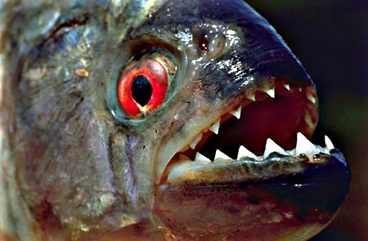
芹川研究室
Background
Recently, a number of foreign creature was pointed as a specialized invasive alien species in Japan
When a invasive alien fish added into a balanced ecological circle, the condition of food sharing, speed of breeding would cause the native weak species disappeared fast if they are not be protected correctly.
This phenomena destroy the ecosystem of native species, and is occurring world wide.
1

Slide 3
Background
芹川研究室
There are 14 kinds of invasive alien fish species in freshwater.
チャネルキャットフィッシュ Channel catfish
ノーザンパイク Northern pike
マスキーパイク Muskellunge
カダヤシ Western mosquito fish
ブルーギル Bluegill
コクチバス Smallmouth bass
オオクチバス Largemouth bass
ストライプトバス Striped bass
ホワイトバス White bass
ストライプトバス×ホワイトバス Sunshine bass
ヨーロピアンパーチ Eurasian perch
パイクパーチ Pikeperch
ケツギョ Mandarin fish
コウライケツギョ Mandarin fish
2
Notes:
MAY TO JULY
AUGEST TO September
October to december

Slide 4
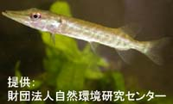
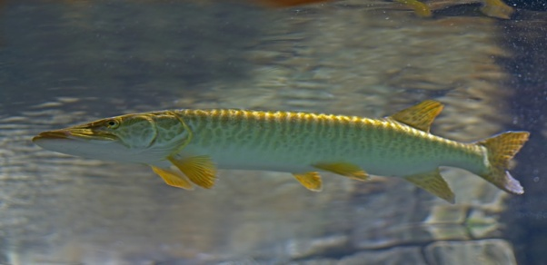
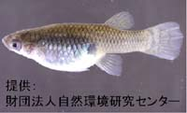
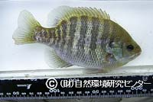
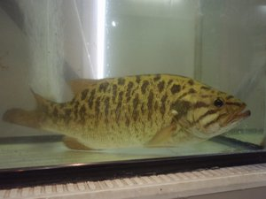
Background
芹川研究室
1 Channel catfish
2.Northern pike
3. Muskellunge
4.Western mosquito fish
5.Bluegill
6.Smallmouth bass
3
Notes:
Ok。let we see the picture to know this fishes

Slide 5
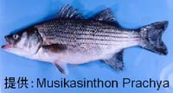
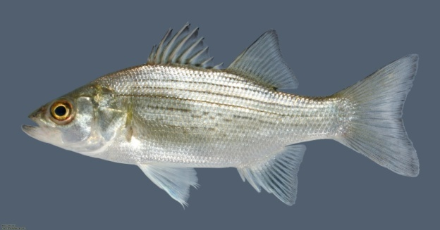
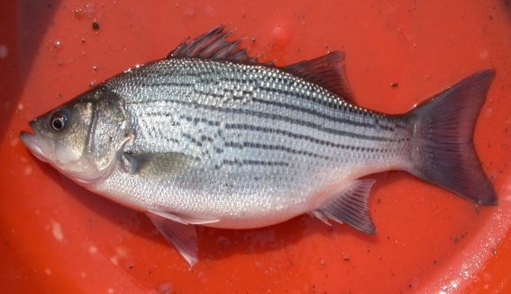
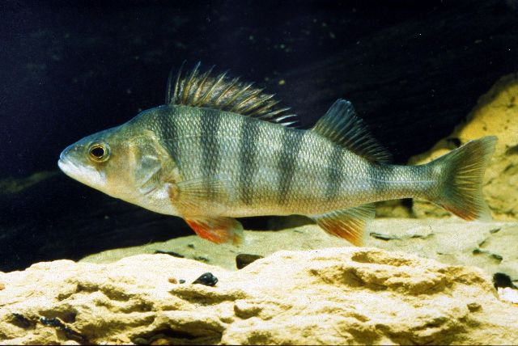
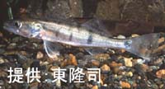
芹川研究室
No.2
7. Largemouth bass
8. Striped bass
9. White bass
10. Sunshine bass
11. Eurasian perch
12.Pikeperch
4

Slide 6
Aim Determine a fish in a picture whether belongs to invasive alien fish species.
芹川研究室
Ways
We catch the body texture pattern after finding the fish-like creature, and make a judgment based in several statistical evaluation parameter.
5

Slide 7
進捗状況（プログラム）Program
芹川研究室
Target Image Collection
Adjust the size of the image.
Use the co-occurrence matrix.
Identify the target species, 3 kinds(crap, sunfish, black bass).
Analyze the statistics about the 3 kinds of fish, use confused occurrence matrix to deal with the characteristic value of the three species of fish.
6
Notes:
In a different background image, we will detect the fish correctly, and the different species are not detected.
recently, l always thinking the problem.

Slide 8
進捗状況（本体）
芹川研究室
7
Notes:
In a different background image, we will detect the fish correctly, and the different species are not detected

Slide 9
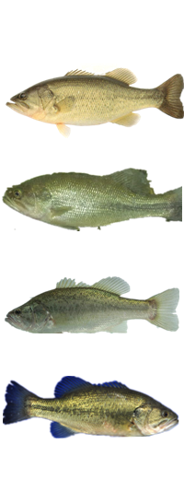
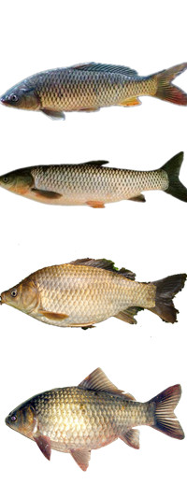
sunfish
In this work ,l collect 3 kinds of fish (crap are 18, sunfish are 7,the black bass are 26)images from the internet. Such as the picture.
crap
black bass
Because of the picture in internet, the picture of size and quality is different, so the first step is to deal with them.
8
Notes:
Each kind of fish ,l choose 4 picture. 但是有效的图片只有草鱼12 黑鱼15 太阳鱼6.

Slide 10
進捗状況（本体）
芹川研究室
In this work , I used co-occurrence matrix to texture analysis from body surface pattern . According to entropy, contrast, relevancy and energy , l can find the difference between 3 kinds of fish.
9
Notes:
熵，对比度，相关度，能量。Entrepi.use

Slide 11
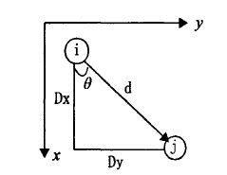
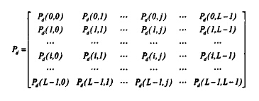
Co-occurrence matrix
芹川研究室
the probability from i
to j using fixed d
10

Slide 12
芹川研究室
Entropy(エントロピー): the amount of information which is the image measurement
Energy(エネルギー): the sum of the squares of the gray level co-occurrence matrix elements, so also known as energy, reflects the image grey distribution uniformity degree of thickness and texture
11

Slide 13
芹川研究室
Contrast: reflects the image of the degree of clarity and texture grooving depth. The contrast is small, the grooving shallow, the picture is fuzzy.
Relevancy : it measures spatial gray level co-occurrence matrix element row or column direction on the similar degree, therefore, the relative value reflects the local gray correlation of image size.
12

Slide 14
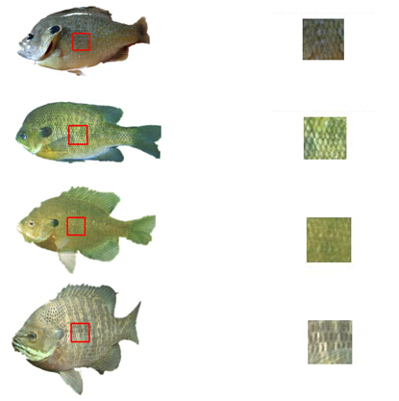
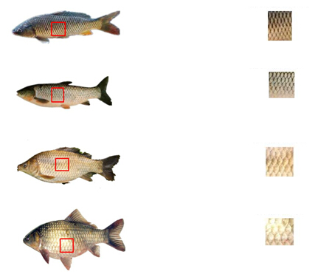
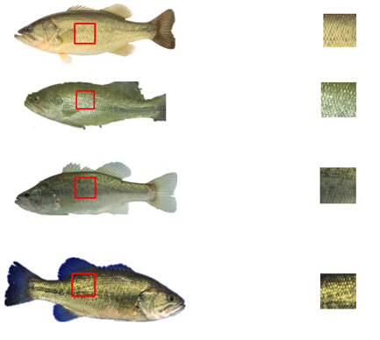
芹川研究室
13

Slide 15
芹川研究室
Lepomis macrochirus may called sunfish
 | ENT | ASM | COR | CON
Sunfish1 | 6.304792 | 0.326916 | 0.769822 | 0.175347
Sunfish2 | 6.850241 | 0.168859 | 0.717723 | 0.431188
Sunfish3 | 6.707572 | 0.242399 | 0.757312 | 0.289802
Sunfish4 | 6.937076 | 0.154762 | 0.829661 | 0.350099
Sunfish5 | 6.849596 | 0.174092 | 0.714613 | 0.434059
Sunfish6 | 6.46464 | 0.248315 | 0.960289 | 0.163465
14

Slide 16
Micropterus dolomieu may called crap
芹川研究室
 | ENT | ASM | COR | CON
Crap1 | 7.280469 | 0.142432 | 0.920069 | 0.235294
Crap2 | 6.153406 | 0.314075 | 0.590833 | 0.281597
Crap3 | 6.892542 | 0.167093 | 0.739633 | 0.397525
Crap4 | 7.319419 | 0.136766 | 0.899992 | 0.273069
Crap5 | 7.415607 | 0.107492 | 0.855374 | 0.49604
Crap6 | 7.348829 | 0.118974 | 0.880836 | 0.404653
Crap7 | 7.64139 | 0.078105 | 0.889574 | 0.608812
Crap8 | 7.394501 | 0.098732 | 0.865682 | 0.536139
Crap9 | 7.142034 | 0.164225 | 0.730818 | 0.800396
Crap10 | 6.989127 | 0.172222 | 0.866153 | 0.31297
Crap11 | 6.874977 | 0.16175 | 0.758798 | 0.38134
Crap12 | 6.460263 | 0.258446 | 0.717317 | 0.275983
15

Slide 17
Ctenopharyngodon idellus may called black bass
芹川研究室
 | ENT | ASM | COR | CON
Black bass1 | 7.459877 | 0.065539 | 0.66272 | 1.098946
Black bass2 | 7.528734 | 0.110282 | 0.908295 | 0.348911
Black bass3 | 7.132297 | 0.17143 | 0.876444 | 0.258416
Black bass4 | 7.264332 | 0.159875 | 0.867029 | 0.360594
Black bass5 | 7.455489 | 0.088082 | 0.890441 | 0.550891
Black bass6 | 7.615071 | 0.107031 | 0.927803 | 0.321502
Black bass7 | 6.792694 | 0.263717 | 0.901 | 0.166931
Black bass8 | 7.38819 | 0.115821 | 0.811434 | 0.520396
Black bass9 | 7.213913 | 0.163613 | 0.885689 | 0.318614
Black bass10 | 7.141529 | 0.089519 | 0.961716 | 0.582475
Black bass11 | 7.375158 | 0.108404 | 0.759582 | 0.840099
Black bass12 | 7.066549 | 0.106036 | 0.650652 | 0.65703
Black bass13 | 7.505202 | 0.140882 | 0.935711 | 0.211409
Black bass14 | 7.778036 | 0.043341 | 0.650229 | 1.744059
16
Notes:
In this form, we can see crap and black bass are very nearly, but the sunfish is very different from the others. So use this way ,we can distinguish the sunfish easily. To crap and black bass, I want to improve this way. Now, I pick up one part in each fish,and some dates are very different with others. So l want to pick up four parts in each fish to get more accuracy dates.

Slide 18
Confused occurrence
芹川研究室
In image accuracy assessment, it is mainly used for comparative classification results and actual measured value.lt shows the result in confusion matrix about the precision of the classification.
 | sample1 | sample2 | sample3 | sample 4
sample1 | a | b | c | d
sample2 | e | f | g | h
sample3 | i | j | k | l
sample4 | m | n | o | p
SUM N=53,
Pe=(8*8+27*25+14*16+4*4)/53/53=0.3485
Pa=(4+20+9+3)/53=0.6792
Kappa=(Pa-Pe)/(1-Pe)=0.51
 | 1 | 2 | 3 | 4 | sum
1 | 4 | 2 | 2 | 0 | 8
2 | 3 | 20 | 4 | 0 | 27
3 | 1 | 3 | 9 | 1 | 14
4 | 0 | 0 | 1 | 3 | 4
sum | 8 | 25 | 16 | 4 | 53
17
Notes:
Sample1 is recognized as the sample2

Slide 19
What is kappa?
芹川研究室
Kappa: a kind of calculation method of classification accuracy. Kappa calculation results is from -1 to 1, but usually kappa is fall between 0 to 1. It can be divided into five groups to represent different levels of consistency.
Interval | Results
0.0-0.20 | low consistency(slight)
0.21-0.40 | general consistency (fair)
0.41-0.60 | medium consistency (moderate)
0.61-0.80 | a high degree of consistency (all)
0.81-1 | almost perfect(almost perfect)

Slide 20
Experimental results
芹川研究室
 | Black bass | Crap | Sunfish | Sum
Black bass | 5 | 0 | 0 | 5
Crap | 3 | 15 | 2 | 20
Sunfish | 0 | 0 | 6 | 6
Sum | 8 | 15 | 8 | 31
Pe | 0.353798127
Pa | 0.838709677
kappa | 0.750402576
Using the two methods, the accuracy can reach seventy-five percent.
18

Slide 21
Plan
芹川研究室
I pick up one part in each fish, and some dates are very different with others. So l want to pick up four parts in each fish to get more accuracy dates.
Improve the accuracy of Confused occurrence.
19

Slide 22
芹川研究室
Thank you

