Slide 1
PRESENTATION
Ge Meng

Slide 2
Review & Summary
Python - Opencv
Some basic operations for Image Processing

Slide 3
Reading
img = cv2.imread(‘route’)
img_gray = cv2.imread(‘route’, 0)
img_gray = cv2.cvtColor(img, cv2.COLOR_BGR2GRAY)
Writing
cv2.imwrite(‘name_save’, img)
Display
cv2.imshow(‘name_window’, img)

Slide 4
Attribute of image
print img.shape
(rows, columns, color_channel)
Resizing
res = cv2.resize(img, None, fx=2, fy=2, interpolation = cv2.INTER_CUBIC)

Slide 5
Translation of Image
#get the size of image
rows, cols, ch = img.shape
#set the translation matrix
M = np.float32([[1,0,100], [0,1,50]])
#translation
dst = cv2.warpAffine(img, M, (cols,rows))

Slide 6
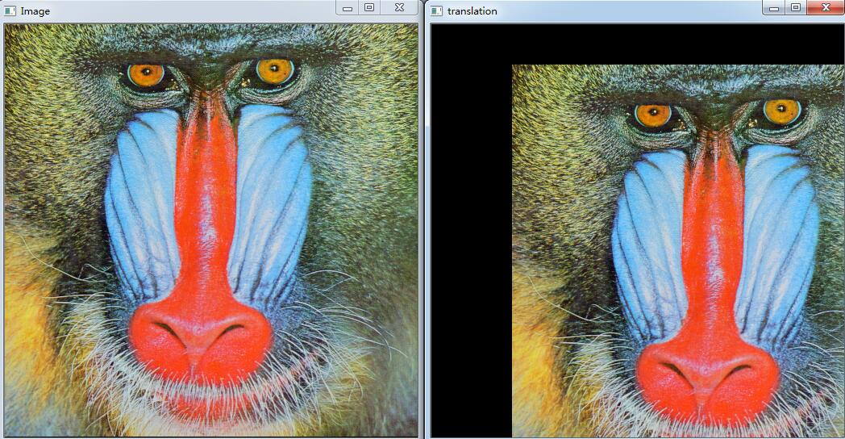

Slide 7
Rotation of Image
#get the size of image
rows, cols, ch = img.shape
#set the rotation matrix
M = cv2.getRotationMatrix2D((cols/2, rows/2),45,1)
#rotate
dst = cv2.warpAffine(img, M, (cols,rows))

Slide 8
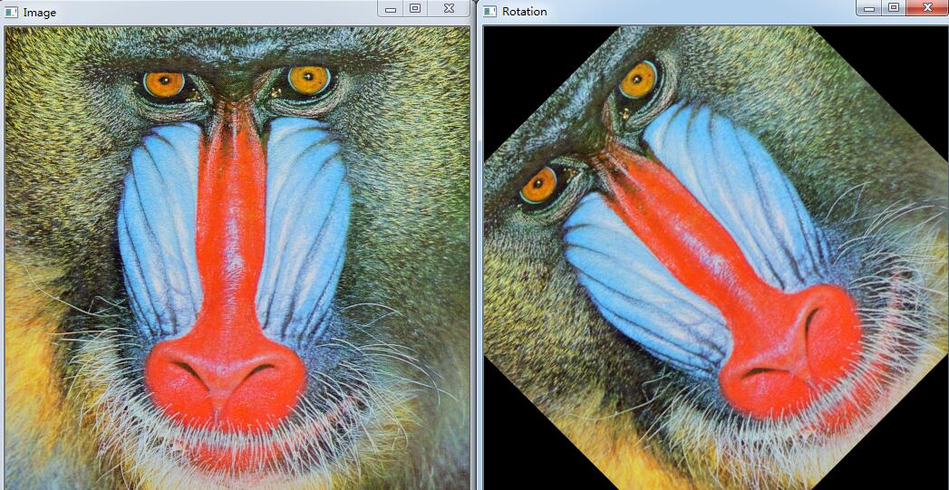

Slide 9
Split and Merge of image channel
#split image to BGR channels respectively
b, g, r = cv2.split(img)
#merge the channels
img = cv2.merge((b, g, r))

Slide 10
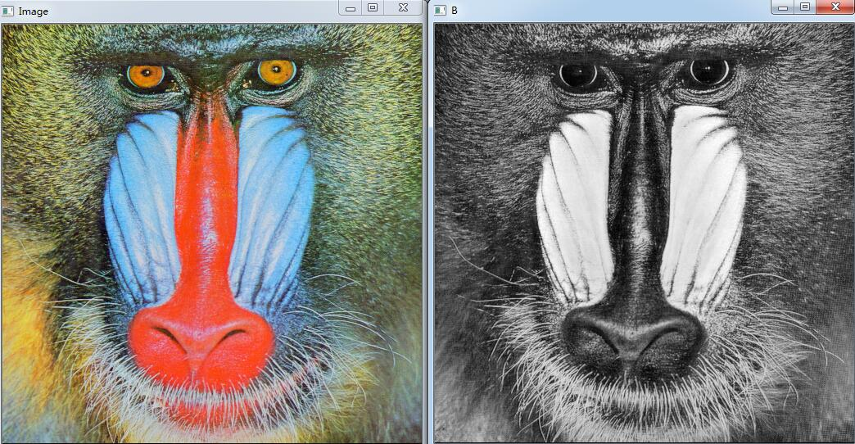
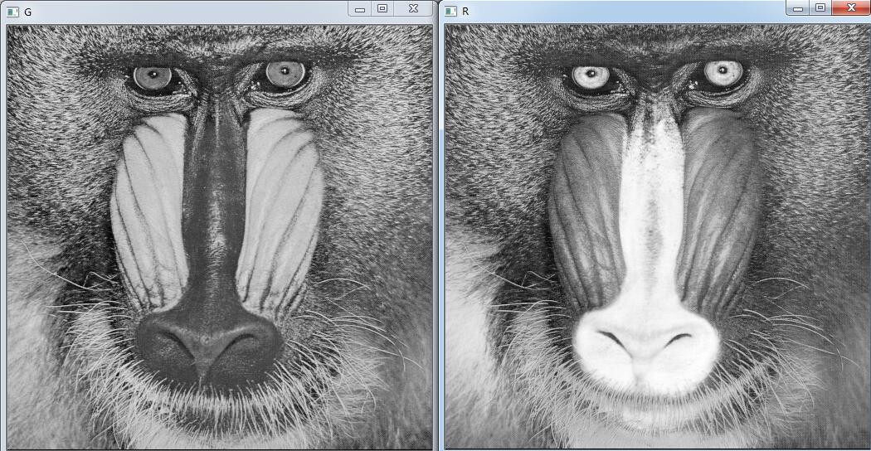

Slide 11
THANK YOU

