Slide 1
LED lighting with PSoC
張研
趙晶晶

Slide 2
CY8C29466
Circuit diagram
Execution on PSoC

Slide 3
CY8C29466
Pinouts Configuration diagram

Slide 4
Features
Powerful Harvard-architecture(処理能力の高いハーバー ド アーキテクチャ プロセッサ)
Advanced peripherals (高度なペ リ フ ェ ラル)
Precision, programmable clocking(プログラム可能な高精度ク ロ ッ ク供給)
Flexible on-chip memory (柔軟性のある内蔵 メ モ リ)

Slide 5
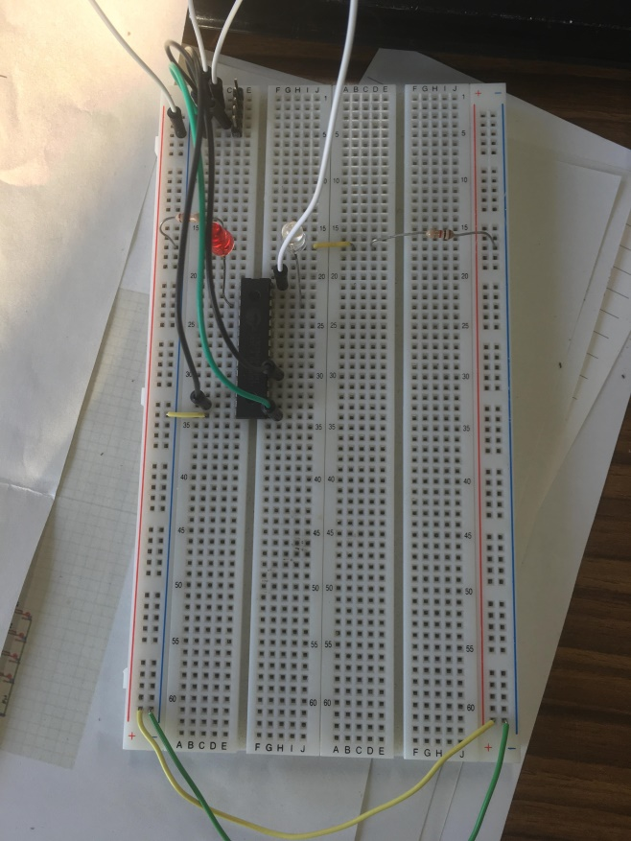
Circuit diagram
It is better to
put a capacitance
Notes:
It can make the current stable, so that the LED will not particularly flash

Slide 6
Execution on PSoC
Create a project on PSoC

Slide 8
2

Slide 11
