Slide 1
PRESENTATION
Ge Meng

Slide 2
Python - Opencv
More operations for Image Processing
Smoothing
Histogram equalization
Binaryzation
Track bar

Slide 3
Smoothing
--- Low-pass filter
Mean filtering
dst_1 = cv2.blur(imag,(5,5))
dst_2 = cv2.boxFilter(imag, -1, (5, 5))

Slide 4
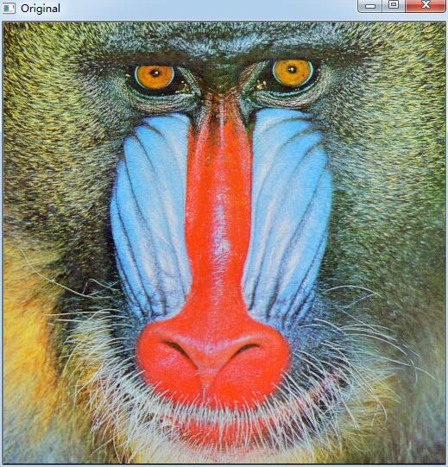

Slide 5
Gaussian blur
guassian = cv2.GaussianBlur(imag, (9,9), 0)

Slide 6
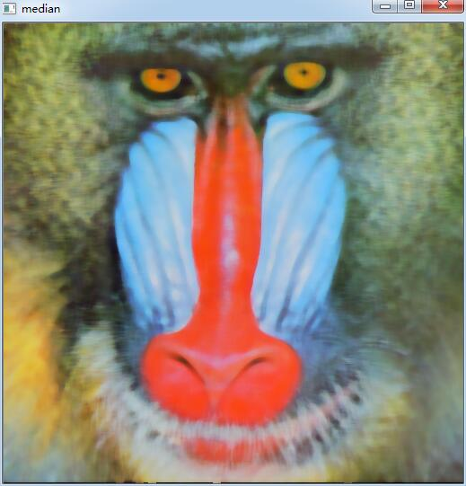
Median filter
median = cv2.medianBlur(imag, 9)

Slide 7
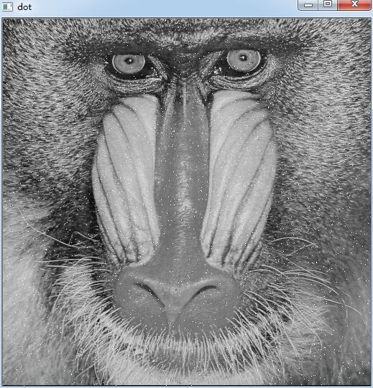

Slide 8
Bilateral filter
bilateral = cv2.bilateralFilter(imag, 9, 75, 75)

Slide 9
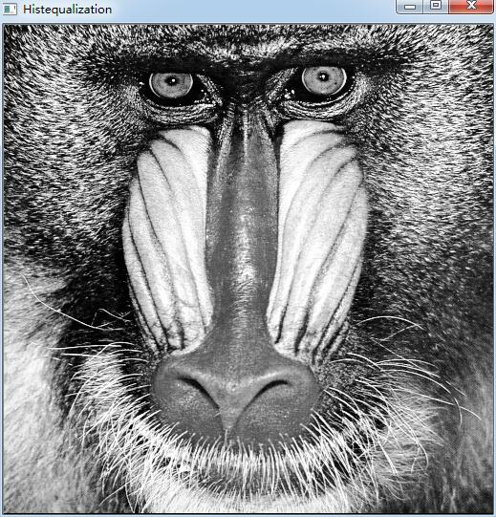
Histogram equalization
histeq = cv2.equalizeHist(gray)

Slide 10
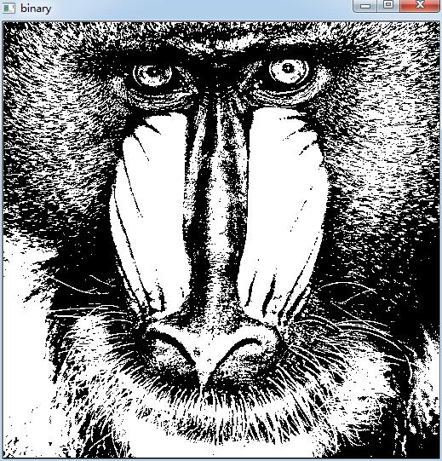
Binaryzation
retval, binary = cv2.threshold(gray, 127, 255, cv2.THRESH_BINARY)

Slide 11
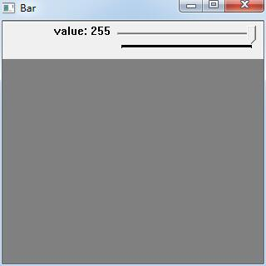
Track bar
cv2.createTrackbar('value', 'Bar', 127, 255, onchange)

Slide 12
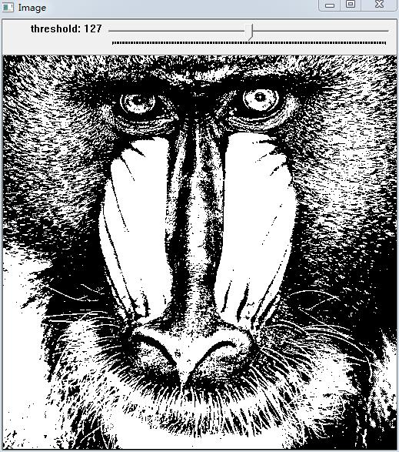
Question

Slide 13
THANK YOU

