Slide 1
PRESENTATION
Ge Meng

Slide 2
Python - Opencv
More operations for Image Processing
Sharpening
Fourier transform
Frequency-domain filtering

Slide 3
Sharpening
--- High-pass filter for edge detection
Sobel operater
x = cv2.Sobel(imag, cv2.CV_16S,1,0)
y = cv2.Sobel(imag, cv2.CV_16S,0,1)
absX = cv2.convertScaleAbs(x)
absY = cv2.convertScaleAbs(y)
sobel = cv2.addWeighted(absX,0.5,absY,0.5,0)

Slide 4
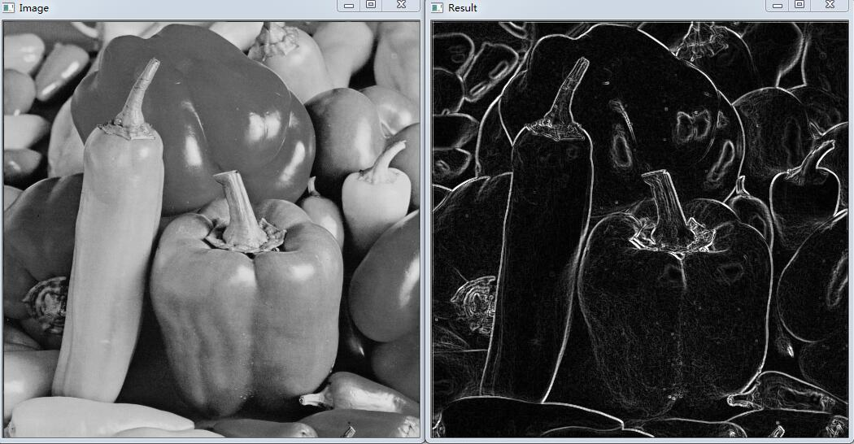

Slide 5
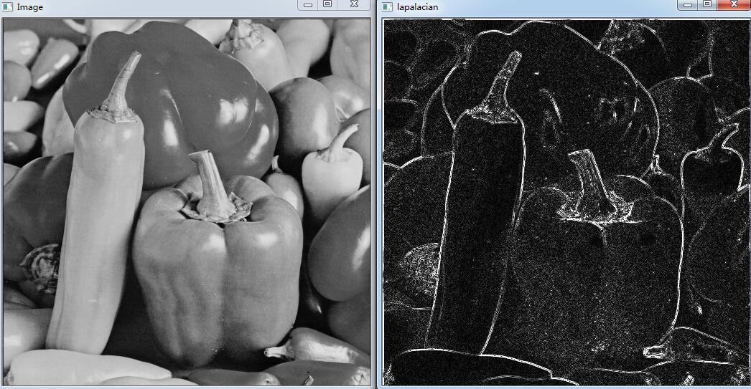
Laplacian operator
lap = cv2.Laplacian(imag, cv2.CV_16S, ksize = 3)
laplacian = cv2.convertScaleAbs(lap)

Slide 6
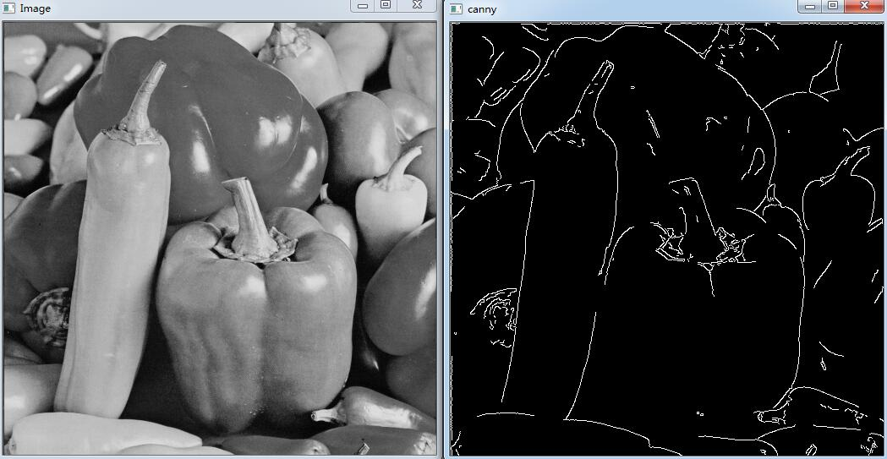
Canny operator
canny = cv2.Canny(imag, 200, 300)

Slide 7
Fourier transform
Forward transform
f = np.fft.fft2(imag)
fshift = np.fft.fftshift(f)
s1 = np.log(np.abs(f))
s2 = np.log(np.abs(fshift))
plt.subplot(121),plt.imshow(s1,'gray'),plt.title('original')
plt.subplot(122),plt.imshow(s2,'gray'),plt.title('center')

Slide 8
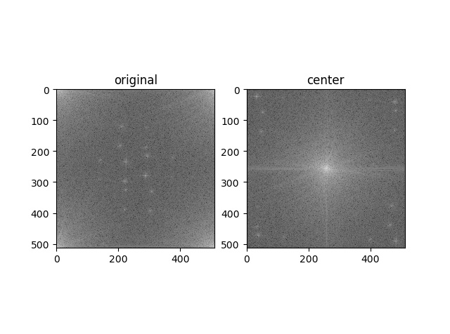

Slide 9
Inverse transform
f1shift = np.fft.ifftshift(fshift)
imag_back = np.fft.ifft2(f1shift)
imag_back = np.abs(imag_back)
plt.subplot(131),plt.imshow(imag,'gray'),plt.title('original')
plt.subplot(132),plt.imshow(s2,'gray'),plt.title('center')
plt.subplot(133),plt.imshow(imag_back,'gray'),plt.title('imag_back')

Slide 10
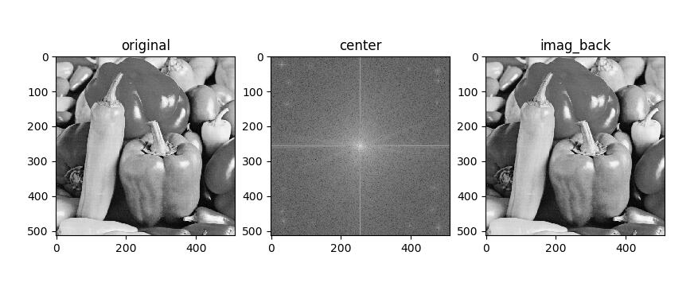

Slide 11
Frequency-domain filtering
--- convolution operation
High-pass filtering
rows,cols = imag.shape
mask = np.ones(img_man.shape,np.uint8)
mask[rows/2-30:rows/2+30,cols/2-30:cols/2+30] = 0
f1 = np.fft.fft2(imag)
f1shift = np.fft.fftshift(f1)
f1shift = f1shift*mask
f2shift = np.fft.ifftshift(f1shift)
high_pass = np.fft.ifft2(f2shift)
high_pass = np.abs(high_pass)

Slide 12
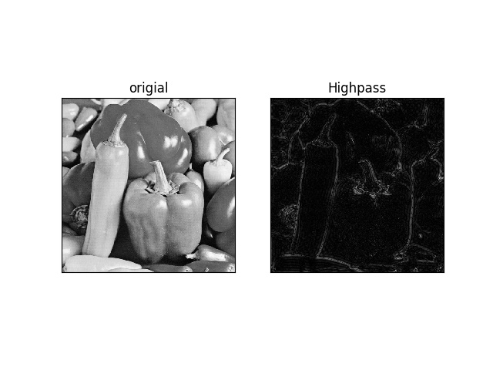

Slide 13
THANK YOU

